Slide 1
Team N
Sakshi Kishor Khanvilkar (x22117776 @student.ncirl.ie)
Sugandha Sharma (x21236577@student.ncirl.ie)

Slide 2
Introduction
The adoption of electric vehicles (EVs) has been on the rise, particularly in urban areas, and as a result, there is an increasing need for electric vehicle charging stations. However, this demand for charging stations can cause challenges for the electric grid, potentially leading to overloading and power outages. To address this issue, we have undertaken a project to analyze EV charging station data and EV population data in the United States. By analyzing this data, we hope to gain insights into the current state of EV charging infrastructure and to identify areas where improvements are needed. In this project, we aim to provide a comprehensive analysis of the EV charging infrastructure in the US and identify potential solutions for addressing the challenges posed by the increasing demand for EV charging stations.

Slide 3
Data Used
Unstructed Data: UpoThe EV_population data's unstructured data was obtained in the form of a JSON file. The JSON file includes information about the population of electric vehicles in the United States. The information includes zip code, state, city, make, model, year, and electric range.
Structured Data: The EV charging station data was obtained as a CSV file comprising information about various charging stations in the United States. Columns in the data include Station_Name, Street_Address, City, State, ZIP, Phone, Status, EV_Plug_Type, and so on.

Slide 4
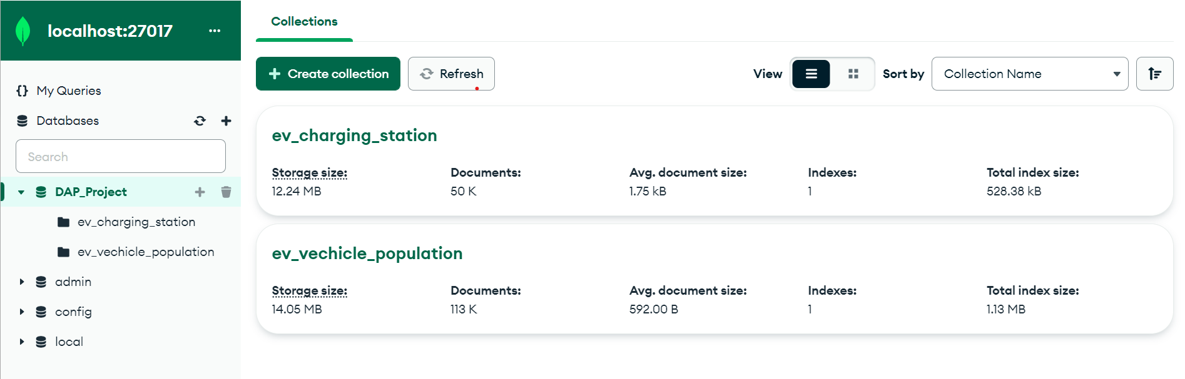
Load data into Mongo Db
The EV charging station data in CSV format was used as structured data in this research. To import the data into MongoDB, we used the PyMongo Python package to connect to the MongoDB server. Then, to hold the EV charging station data, we established a database called 'DAP_Project' and a collection called 'ev_charging_station'.

Slide 5
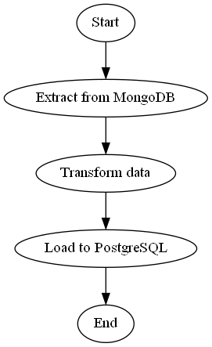
ETL Process
The ETL (Extract, Transform, Load) process was applied to the data, which involved cleaning and transforming the data to make it suitable for analysis. This process included handling missing data, converting data types, and creating new columns based on the existing data.

Slide 6
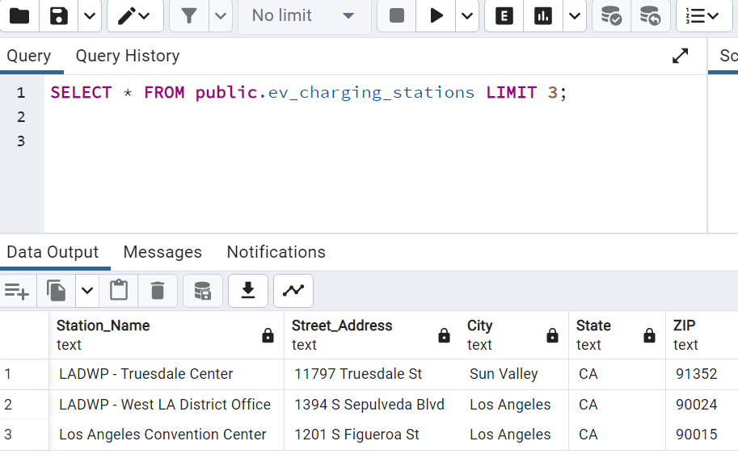
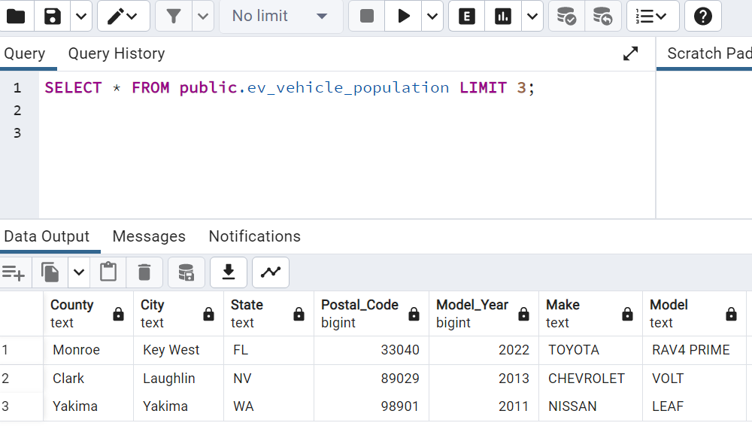
Load data into Postgres DB
By storing the data in a PostgreSQL database, we can leverage the capabilities of SQL to easily query and manipulate the data, as well as utilize a variety of analytics tools for deeper insights.

